Slide 1
RetinaScope
AI
AI-Based Retinal Vessel Segmentation
& Diabetic Retinopathy Grading
Aymen Slimani
Başar yıldırım
Project — RetinoHelpers
github.com/AYMENsl25/Retinal-dr-detection

Slide 2
The Problem — Clinical Motivation
7M
25–35%
#1
Diabetic patients
in Turkey
Will develop
Diabetic Retinopathy
Cause of preventable
blindness
The Access Gap
Ophthalmologists are concentrated in urban centres. Rural patients have NO access to screening.
An AI-powered offline screening tool can shift detection to Grade 0–1, preventing irreversible blindness.
By the time patients notice vision loss, DR is already at Grade 3–4 — requiring laser or vitreoretinal surgery.
RetinaScope-AI v2 · Aymen Slimani · TÜBİTAK · 2026
Problem

Slide 3
Our Solution — RetinaScope-AI v2
Two-stage deep learning pipeline for automated DR screening
🩸
Vessel Map
🔬
Lesion Maps
Binary segmentation of all retinal blood vessels using Teacher-Student KD ensemble
MA, HE, EX, OD — 4 pathological classes via pretrained-encoder ensemble
🏥
DR Grade 0–4
🧠
Explainability
Severity grading via 9-channel classifier (RGB + segmentation masks)
GradCAM++ heatmap + MC Dropout uncertainty for clinical trust
RetinaScope-AI v2 · Aymen Slimani · TÜBİTAK · 2026
Solution Overview

Slide 4
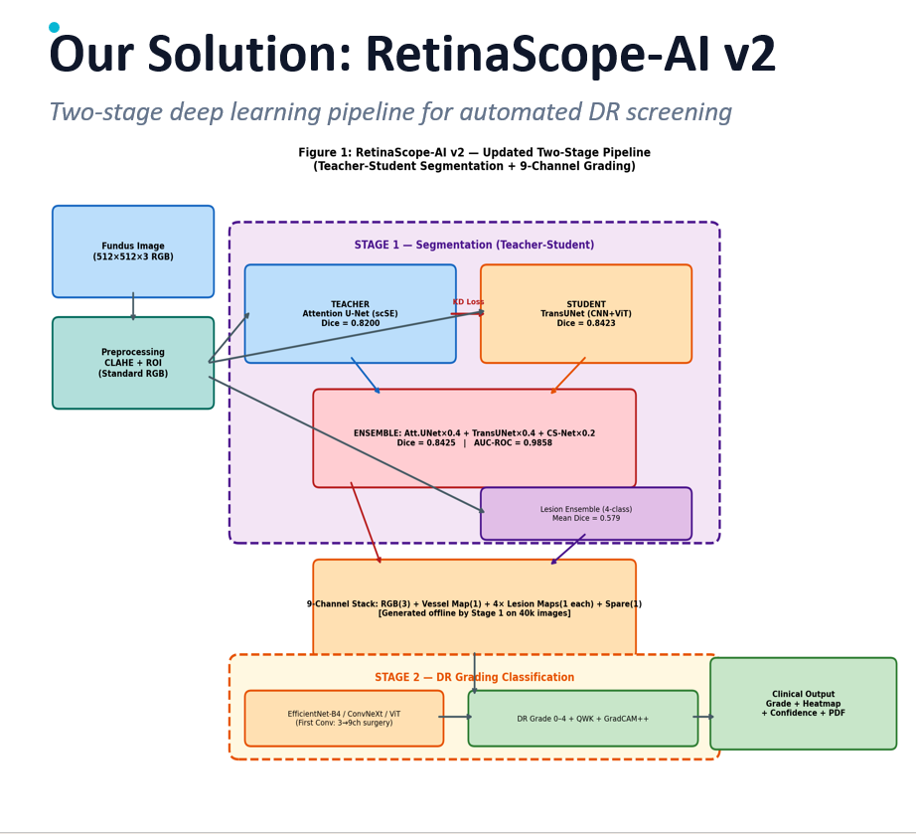

Slide 5
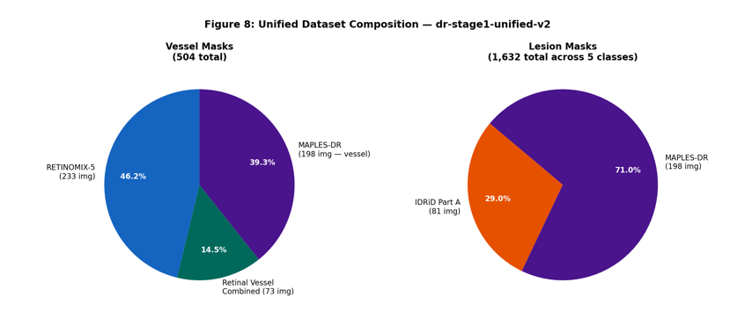
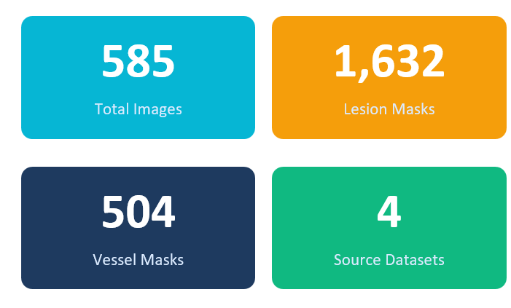
Dataset — dr-stage1-unified
4 sources unified — publicly released on Kaggle (CC BY 4.0)
Source | Images | Mask Type | Classes
RETINOMIX-5 | 233 | Vessel masks | —
Retinal Vessel Combined | 73 | Vessel masks | —
IDRiD Part A | 81 | Lesion masks | MA, HE, EX, SE, OD
MAPLES-DR | 198 | Vessel + Lesion masks | MA, HE, EX, OD, NV, CW
TOTAL (Stage 1) | 585 | 504 vessel / 1,632 lesion | 7 types (4 used)
EyePACS 2015 + APTOS 2019 | 40,380 | DR grade labels (0–4) | (grading only) 0-4
585
504
1,632
4
Total Images
Vessel Masks
Lesion Masks
Source Datasets
🔗 kaggle.com/aymenslimani/dr-stage1-unified-v2
RetinaScope-AI v2 · Aymen Slimani · TÜBİTAK · 2026
Dataset

Slide 6
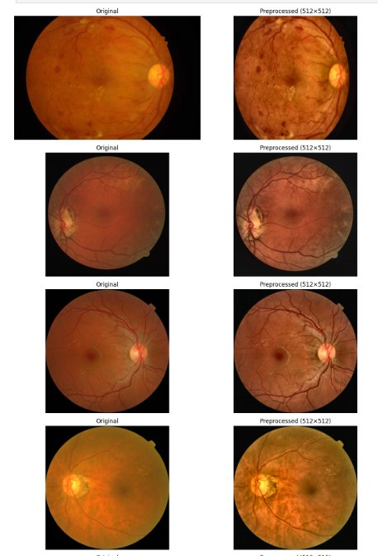
Preprocessing Pipeline
Standardized across all camera sources
01
Resize to 512×512
Standardize spatial dims across all datasets
02
CLAHE Enhancement
Contrast Limited Adaptive Histogram Equalization
03
ROI Circular Mask
Remove black vignette borders
04
ImageNet Normalize
mean=[0.485,0.456,0.406] std=[0.229,0.224,0.225]
Original → Preprocessed (512×512)
RetinaScope-AI v2 · Aymen Slimani · TÜBİTAK
⚠ Green Channel Injection ablation: mixed results (±0.003 Dice) — RGB retained as standard
Preprocessing

Slide 7
Stage 1 — 9-Architecture Vessel Segmentation Benchmark
Identical CFG across all models — fair, controlled comparison
Architecture | Category | Dice ↑ | IoU ↑ | AUC-ROC ↑
U-Net (ResNet34) | CNN Baseline | 0.7924 | 0.6561 | 0.9751
U-Net++ (ResNet34) | CNN Baseline | 0.7922 | 0.6559 | 0.9712
Attention U-Net (scSE) ★ TEACHER | Advanced CNN | 0.8200 | 0.6970 | 0.9801
CS-Net ★ STUDENT (KD) | Advanced CNN | 0.8156 | 0.6912 | 0.9825
TransUNet | CNN+Transformer | 0.8034 | 0.6950 | 0.9782
FSG-Net | Advanced CNN | 0.8145 | 0.6985 | 0.9701
MultiResU-Net | Advanced CNN | 0.7971 | 0.6490 | 0.9771
Bi-DLKA U-Net | Advanced CNN | 0.7909 | 0.6541 | 0.9748
Swin-Unet ★ STUDENT (KD) | Pure Transformer | 0.7925 | 0.6576 | 0.9740
TransUNet ★ STUDENT (KD) | CNN+Transformer | 0.8403 | 0.7302 | 0.9852
🏆 FINAL ENSEMBLE
swin×0.3+Trans×0.5
+CS×0.2
0.8425
Dice
0.7315
IoU
0.9858
AUC-ROC
0.8695
Sensitivity
RetinaScope-AI v2 · Aymen Slimani · TÜBİTAK · 2026
Stage 1 — Benchmark

Slide 8
Teacher-Student Knowledge Distillation
Soft-label supervision from CNN teacher → Transformer student
Phase A — Teacher Training
Phase B — Student Training
Weighted Soft Ensemble
Attention U-Net (scSE)
Standard CFG + Dice+BCE loss
Soft probability maps saved
Dice = 0.8200
TransUNet (CNN+ViT)
L = 0.6×(Dice+BCE) + 0.3×KD_MSE + 0.1×Aux
KD_Loss = MSE(student_probs, teacher_probs)
Dice = 0.8423 (+0.0223 vs teacher)
SwinUNet × 0.3 + TransUNet × 0.5 + CS-Net × 0.2
Final Dice = 0.8425
AUC-ROC = 0.9858
Best combined result
Dice Score Progression
0.8200 Teacher (Att.UNet)
(no KD)
0.8403 Student + KD ✓
0.8425 Ensemble 🏆
RetinaScope-AI v2 · Aymen Slimani · TÜBİTAK · 2026
Teacher-Student KD

Slide 9
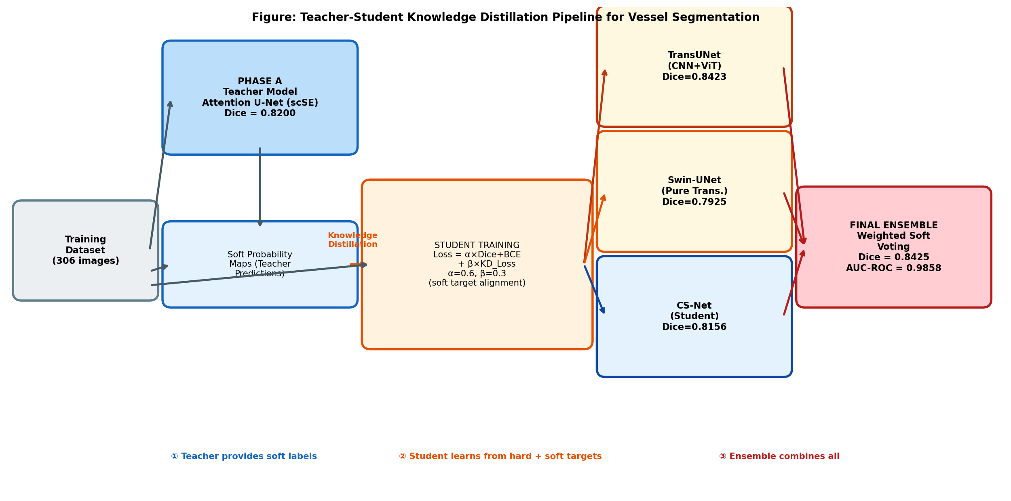
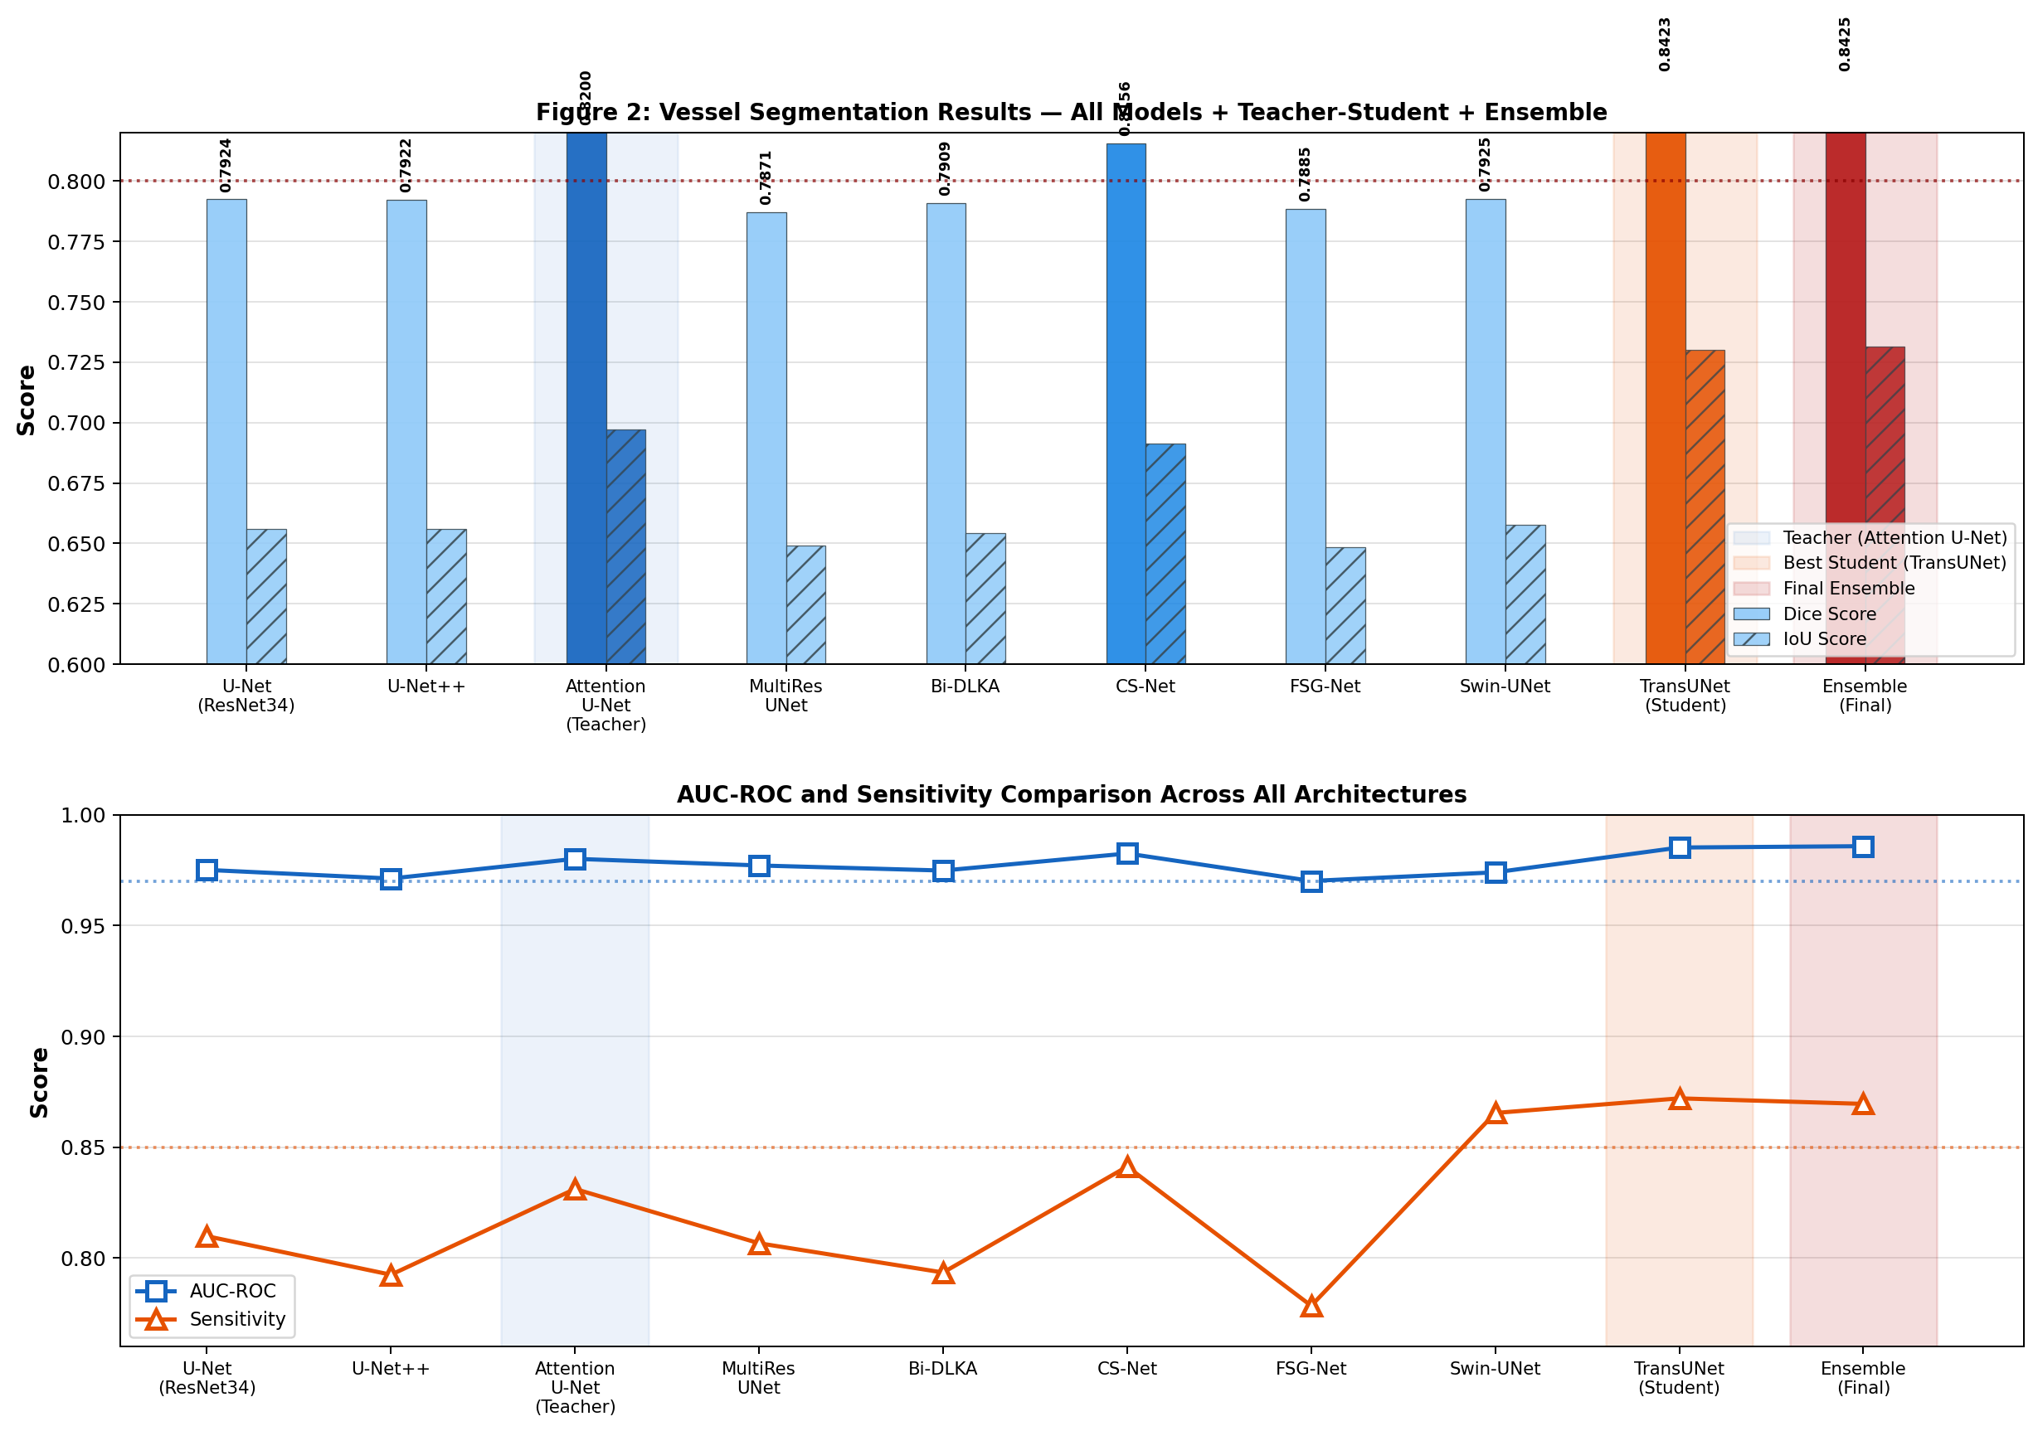
Teacher-Student Knowledge Distillation
Soft-label supervision from CNN teacher → Transformer student
KD Loss Formula
L = 0.6×(Dice+BCE)
+ 0.3×KD_MSE
+ 0.1×Aux
Dice Improvement
Teacher (att.UNet)
0.8200
Student (no KD)
0.7891
Student (with KD)
0.8403
Ensemble
0.8425
+0.0223 gain
RetinaScope-AI v2 · Aymen Slimani · TÜBİTAK

Slide 10
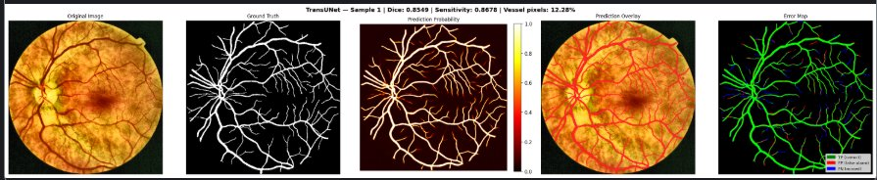
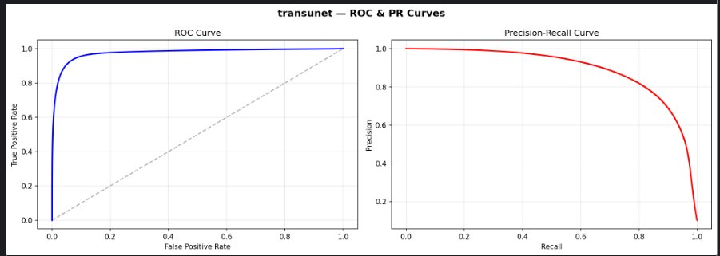
Vessel Segmentation — Qualitative Results
TransUNet (Student) prediction on test sample
TransUNet (Student) | Dice = 0.8349 | Sensitivity = 0.8678 | Vessel pixels: 12.28%
0.8425
Dice
0.7315
IoU
0.9858
AUC-ROC
0.8695
Sensitivity

Slide 11
MTKD Student — Final Test Results
0.8425
0.7315
0.9736
0.8868
0.9858
Dice Score
IoU (Jaccard)
AUC-ROC
AUC-PR
Specificity
Training Insights (TransUNet — 87 Epochs)
Literature Comparison
• Val Dice rises steadily 0.65 → 0.80
• Validation curve consistently ABOVE training → good generalisation
• Specificity >0.95 throughout all epochs
• Sensitivity stable at 0.80–0.87
• Early stopping at patience=12 prevents overfitting
Method | Dice | AUC
U-Net (2015) — DRIVE | 0.7537 | 0.9820
Attention U-Net — DRIVE | 0.8149 | 0.9870
FSG-Net (2025) — DRIVE | 0.8407 | 0.9824
★ Ours — Ensemble | 0.8425 | 0.9858
RetinaScope-AI v2 · Aymen Slimani · TÜBİTAK · 2026
MTKD Test Results

Slide 12
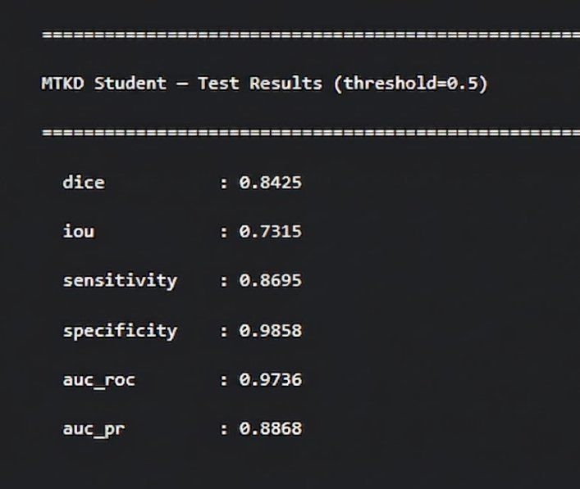
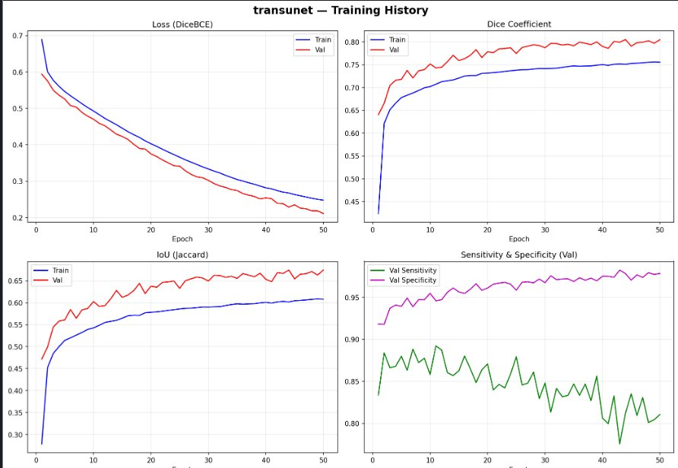
Final MTKD Student — Test Results
MTKD Results
0.8425
0.7315
0.9736
0.8868
0.9858
Dice
IoU
AUC-ROC
AUC-PR
Specificity
RetinaScope-AI v2 · Aymen Slimani · TÜBİTAK
MTKD Test Results

Slide 13
Stage 1 — 4-Class Lesion Segmentation
Per-channel weighted loss to handle extreme pixel imbalance
MA
HE
EX
OD
Microaneurysms
Haemorrhages
Hard Exudates
Optic Disc
Weight: × 3.0
Weight: × 2.5
Weight: × 1.5
Weight: × 0.5
0.453
0.653
0.656
0.953
Dice
Dice
Dice
Dice
🏆 Ensemble Mean Dice = 0.679 (Att.UNet + UNet++ + YOLOv11)
⚠ Key Finding: From-scratch architectures (CS-Net, BiDLKA, FSGNet, MultiResUNet) collapsed to near-zero Dice on MA/HE/EX. Pretrained encoders are mandatory for small datasets.
OD detection near-perfect (0.953). MA hardest class — tiny lesions ~0.003% pixel coverage.
RetinaScope-AI v2 · Aymen Slimani · TÜBİTAK · 2026
Lesion Segmentation

Slide 14
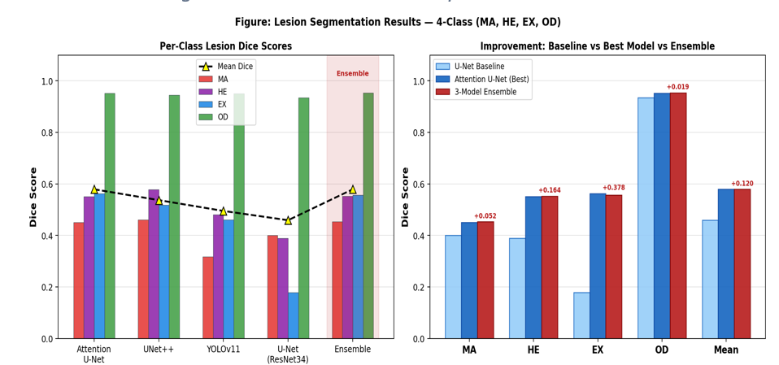
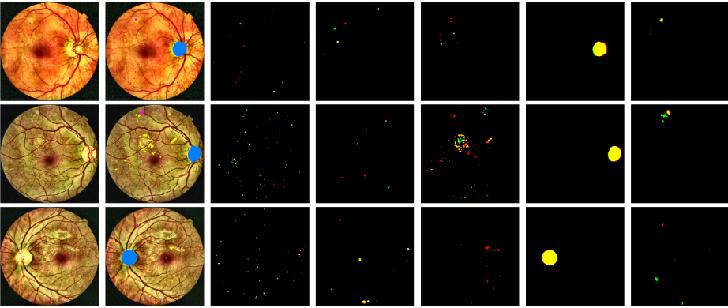
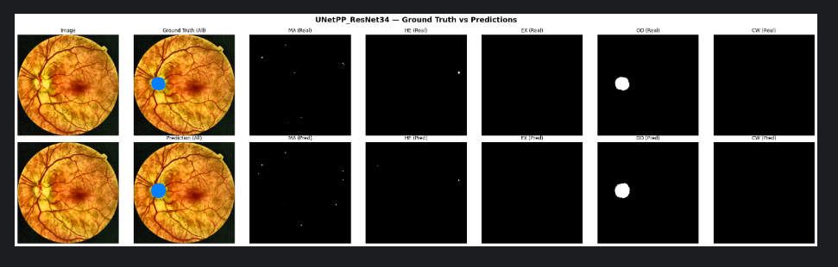

Slide 15
Stage 2 — 9-Channel DR Grading Classification
First-Conv Surgery: in_channels 3→9, ImageNet weights preserved
Ch 1-3
Ch 4
Ch 5
Ch 6
Ch 7
Ch 8
Ch 9
RGB
Vessel
Mask
MA
Mask
HE
Mask
EX
Mask
OD
Mask
Spare
512×512×9 Tensor
Architecture | QWK ↑ | AUC macro ↑ | F1 macro ↑ | Accuracy ↑
ConvNeXt-Base (9ch) ★ | 0.9598 | 0.9883 | 0.9274 | 0.9488
EfficientNet-B4 (9ch) | 0.8945 | 0.9345 | 0.8875 | 0.8732
ViT-Base/16 (9ch) | 0.9152 | 0.9564 | 0.9241 | 0.9034
0.9598
Grading QWK
(ConvNeXt-Base)
First-Conv Surgery: Copy pretrained RGB weights to channels 0–2. Initialize channels 3–8 with mean(RGB weights). QWK is the primary checkpoint metric — penalizes ordinal errors proportionally (predicting Grade 4 when true label is Grade 0 = severe clinical error).
RetinaScope-AI v2 · Aymen Slimani · TÜBİTAK · 2026
Stage 2 — Grading

Slide 16
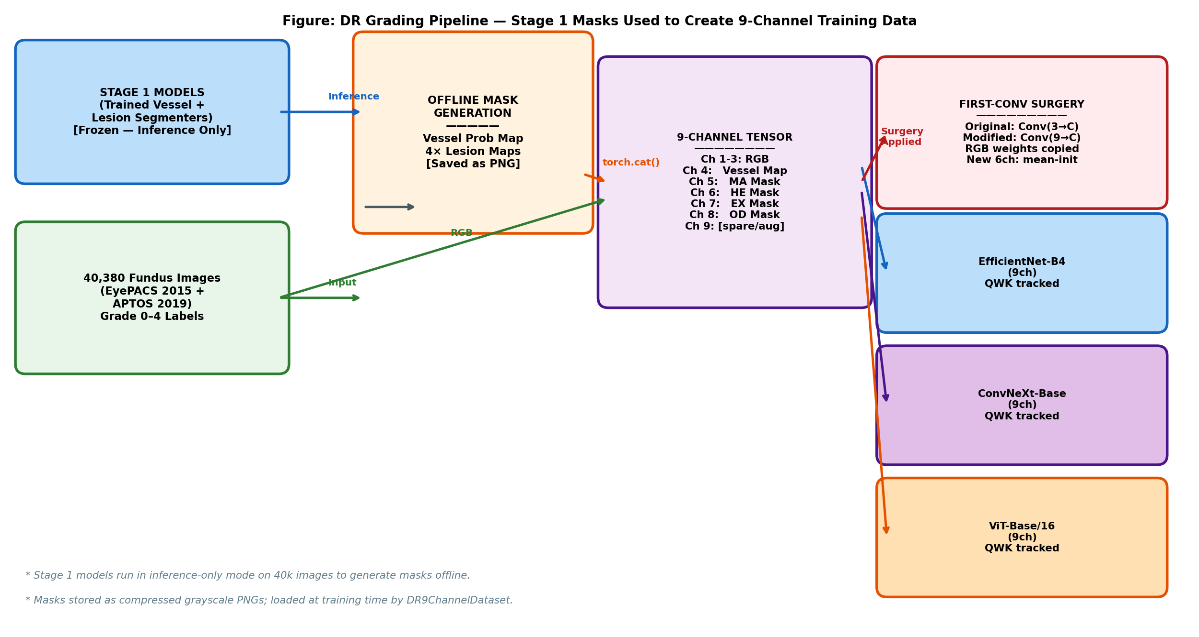
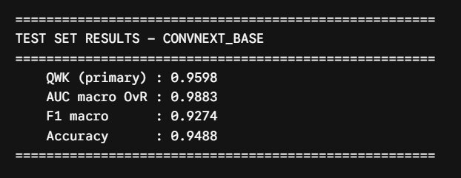
Stage 2: 9-Channel DR Grading Classification
First-Conv Surgery: in_channels 3 → 9, ImageNet weights preserved
0.9598
0.9883
QWK (primary)
AUC macro
0.9274
0.9488
9 Channels = RGB(3) + Vessel(1) + MA(1) + HE(1) + EX(1) + OD(1) + Spare(1)
F1 macro
Accuracy
ConvNeXt-Base | QWK=0.9598 | AUC=0.9883 | F1=0.9274 | Acc=0.9488
First-Conv Surgery: Copy RGB weights to ch 0-2
Init ch 3-8 with mean(RGB weights)
RetinaScope-AI v2 · Aymen Slimani · TÜBİTAK
Stage 2 — Grading

Slide 17
Live Demo — RetinaScope-AI Web Application
FastAPI backend · React clinical frontend · Full pipeline online
🏥
Grade 2 — Moderate NPDR
🔍
Vessel & Damage Panels
📊
MC Dropout σ = 0.050
ICDR Grade + confidence displayed
Full softmax distribution per grade
5-panel visualization
Zoom crops on detected lesions
Uncertainty quantification built-in
Entropy = 0.21 (confident prediction)
📄
PDF Clinical Report
🤖
Gemini Flash LLM
🛡
No Specialist Required
Exportable clinical summary
GradCAM++ heatmap included
AI-powered clinical explanation
Natural language DR interpretation
Rural-ready offline-capable
Grade 0–1 early detection
RetinaScope-AI v2 · Aymen Slimani · TÜBİTAK · 2026
Live Demo

Slide 18
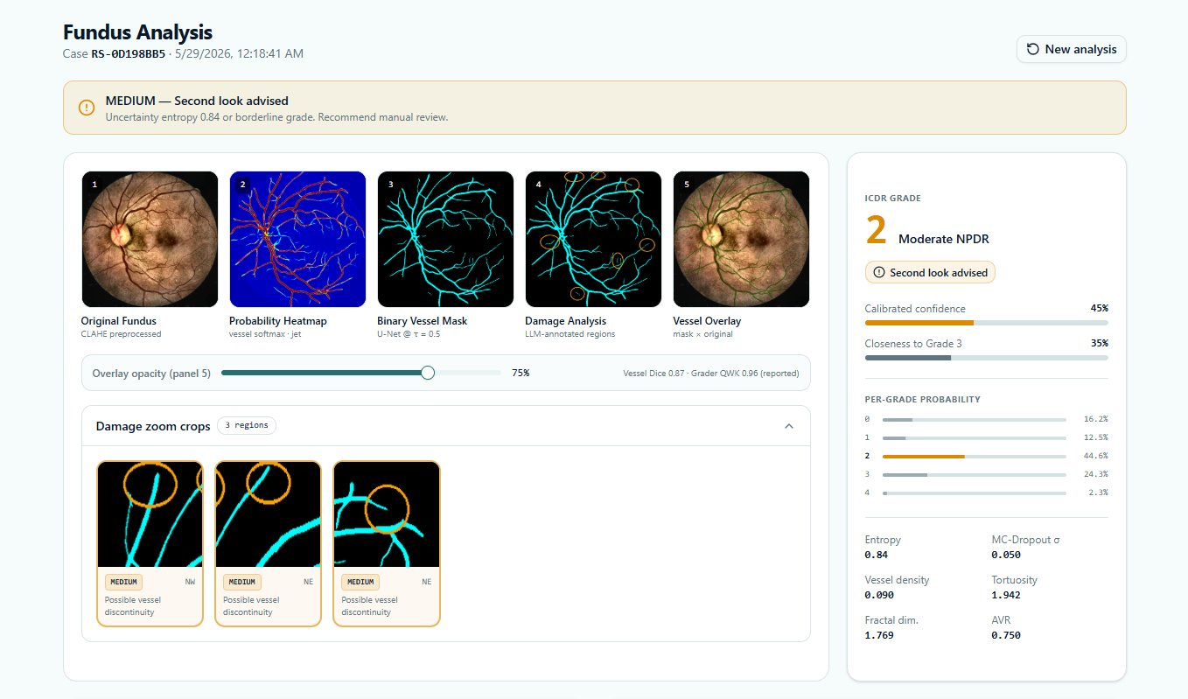
Live Demo — RetinaScope-AI Web Application
FastAPI + React
Grade 2 — Moderate NPDR
Per-Grade Probabilities
Vessel & Damage Panels
MC Dropout σ = 0.050
RetinaScope-AI v2 · Aymen Slimani · TÜBİTAK
Live Demo
ICDR Grade + confidence 45%
Full softmax distribution shown
5-panel visualization + zoom crops
Uncertainty quantification built-in

Slide 19
Results Summary — All Targets Met or Exceeded
Objective | Target | Achieved | Status
Vessel Dice | ≥ 0.80 | 0.8425 | ✅ Exceeded
Vessel AUC-ROC | ≥ 0.97 | 0.9858 | ✅ Exceeded
Teacher→Student KD gain | > 0 | +0.0223 | ✅ Confirmed
Lesion Mean Dice (4-class) | ≥ 0.55 | 0.679 | ✅ Exceeded
Grading QWK (ConvNeXt) | ≥ 0.80 | 0.9598 | ✅ Achieved
Grading AUC macro | ≥ 0.95 | 0.9883 | ✅ Exceeded
FastAPI end-to-end verified | Pass | All 6 models loaded | ✅ Verified
Green Channel Ablation | Document | Mixed ±0.003 | ✅ Completed
40k Offline Masks | 40,380 PNGs | Completed | ✅ Done
RetinaScope-AI v2 · Aymen Slimani · TÜBİTAK · 2026
Results Summary

Slide 20
Deployment
Currently live — Edge deployment as next milestone
✅ LIVE NOW — Web Application
🗓️ FUTURE — Jetson Nano Edge Device
✓ FastAPI backend — REST API
NVIDIA Jetson Nano (4GB)
✓ React frontend — Clinical UI
Edge inference — fully offline
✓ Full pipeline: Vessel + Lesion + Grade
Portable Fundus Camera
EE sub-team — $200–500 vs $30k
✓ GradCAM++ explainability heatmap
TensorRT INT8 Quantization
✓ MC Dropout uncertainty score
Target: < 2s inference/image
✓ PDF clinical report export
No internet required
✓ Gemini Flash LLM explanation
Rural clinic deployment ready
✓ No specialist required
Qt touchscreen interface
7-inch display with grade + heatmap
[ Jetson Nano + Portable Camera screenshot to be added ]
RetinaScope-AI v2 · Aymen Slimani · TÜBİTAK
Deployment

Slide 21
Future Work
Three directions — short / mid / long term
Short Term
Mid Term
Long Term
Complete grading: EfficientNet-B4 + ViT-Base/16 training runs
Lesion improvement: Tversky loss + patch training → target Dice > 0.67
Jetson Nano: TensorRT INT8 → sub-2s inference + portable camera integration
Cross-dataset validation on IDRiD Part B holdout (516 images)
Per-channel threshold optimization (free +1–3% Dice)
Phase B custom arch: BiFormer + EMCAD + DDSP → target Dice > 0.85
GradCAM++ validation with ophthalmology reviewer
Test-Time Augmentation (8× geometric) → +2–4% Dice
Research paper submission (IEEE Trans. Medical Imaging)
RetinaScope-AI v2 · Aymen Slimani · TÜBİTAK
Future Work

Slide 22
Thank You
Key Contributions
Links & Resources
▸ Unified public dataset (585 images, CC BY 4.0)
GitHub:
github.com/AYMENsl25/
Retinal-dr-detection
▸ Teacher-Student KD: Dice 0.8200 → 0.8423 (+0.0223)
Dataset:
kaggle.com/aymenslimani/
dr-stage1-unified-v2
▸ 9-architecture controlled benchmark
▸ 9-channel grading: QWK=0.9598, AUC=0.9883
Best Model:
MTKD Ensemble
Dice = 0.8425
▸ Deployed FastAPI + React web application
Grading:
ConvNeXt-Base
QWK = 0.9598
Aymen Slimani · Software Engineering · Istanbul University-Cerrahpasa · 2026

